Slide 1
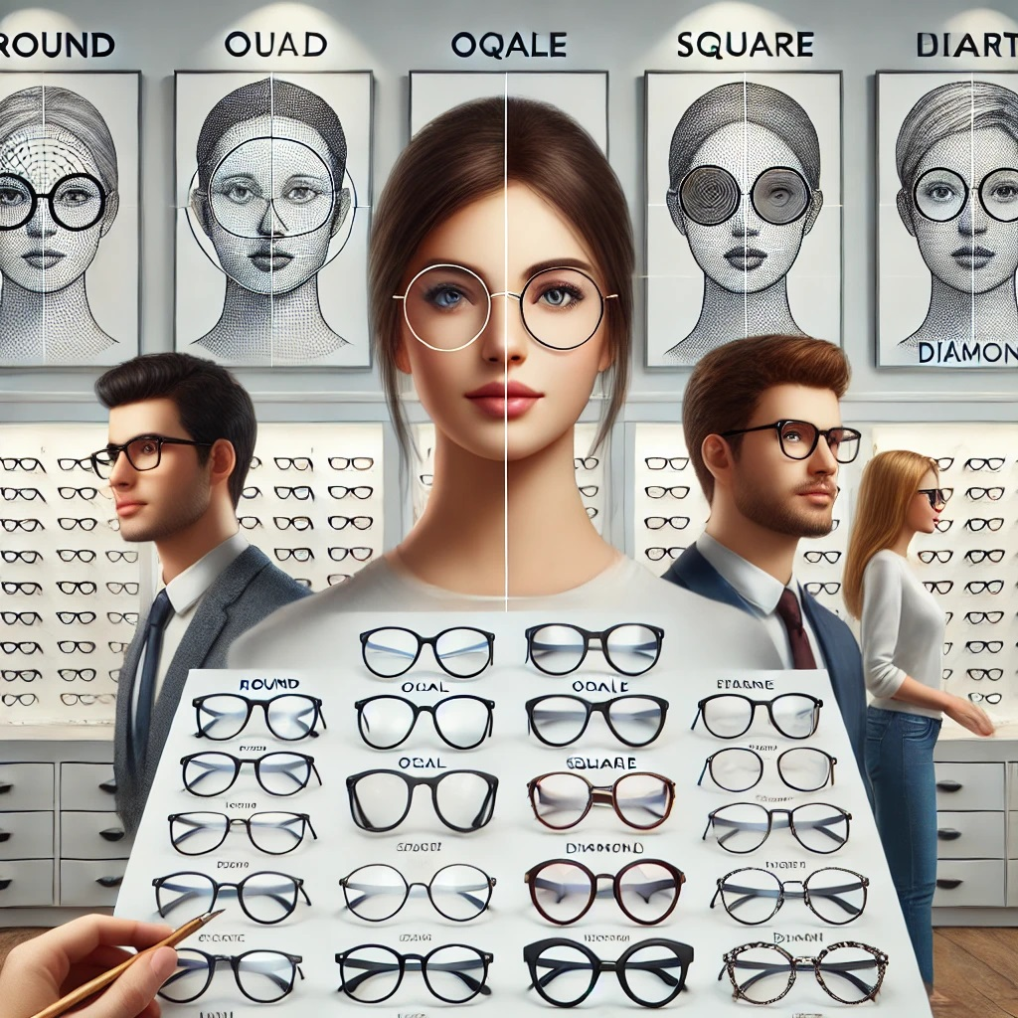
LOOK: EYE GLASS RECOMMENDATION SYSTEM BASED ON FACE SHAPE USING CNN MODEL
012-Hemara
013-Hamdha
014-Lakshika

Slide 2
Contents
1. Product Name
2. Problem Statement
3. Target Users
4. Business Impact

Slide 3
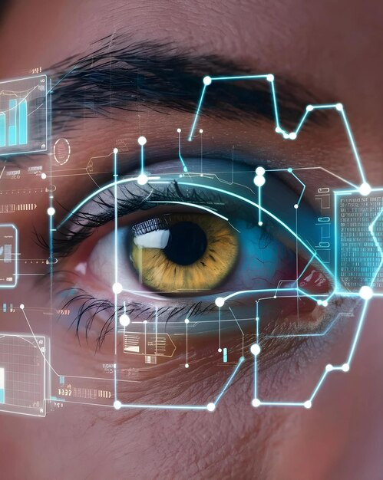

LOOK helps you find your look, try your look, and own your look

Slide 4
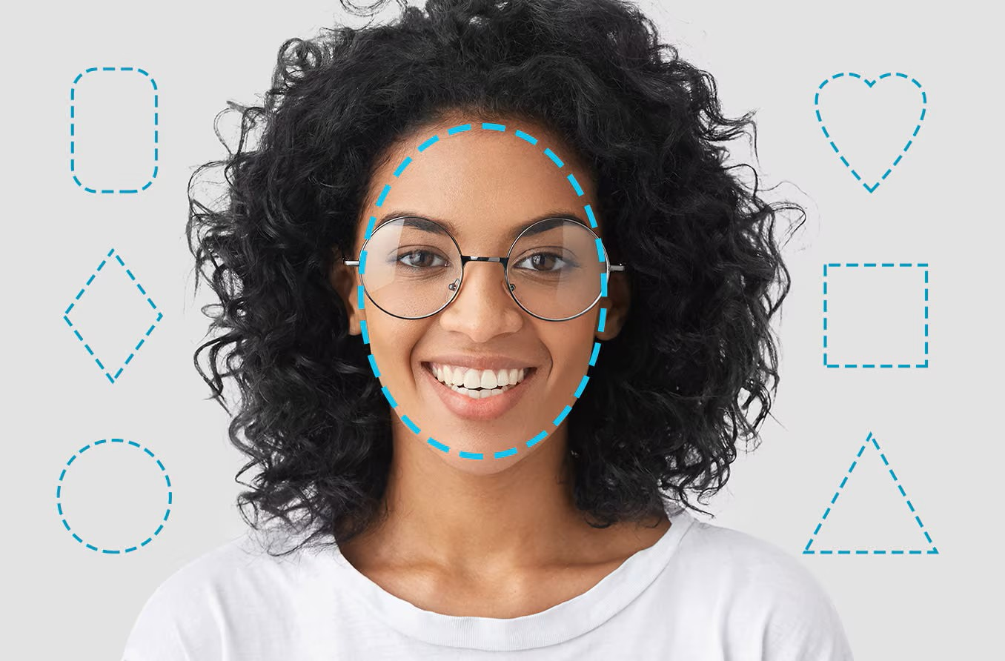
As a Verb: "Take a LOOK at these glasses" - The action of searching, exploring, and discovering eyewear options.
As a Noun: “Your perfect LOOK" – The final style, appearance, and confidence that comes from wearing well fitted glasses.
L - Learning (Deep Learning/CNN)
O - Optical (Eyewear focus)
O - Optimization (Perfect fit)
K - Knowledge (AI-powered insights)

Slide 5
PROBLEM Statement
LOOK uses deep learning to analyze facial geometry and provide personalized virtual try-on recommendations, eliminating guesswork from eyewear shopping.
ONLINE PROBLEM | IN-STORE PROBLEM
25-30% return rate due to wrong fit (National Retail Federation-2023) | Take a long time for decision & wasting Staff’s time
Can’t try before buying | Overwhelm and fatigue
No personalized advice | Suboptimal purchases due to rush decision

Slide 6
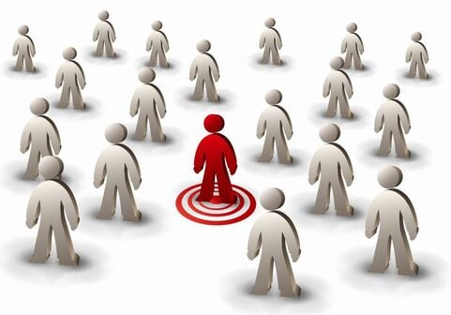
Target Users
Primary Users:
Online Eyewear Shoppers
In-Store Optical Customers.
2. Secondary Users:
Eyewear Retailers.
Optical Industry Professionals.

Slide 7
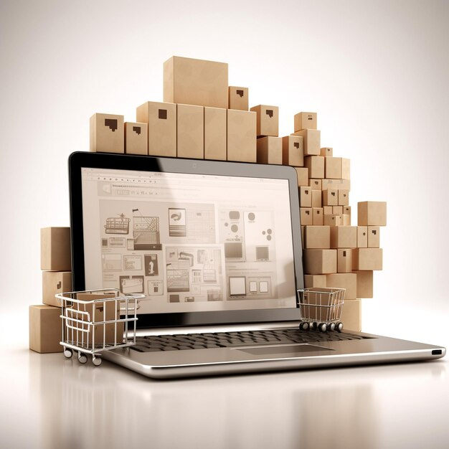
Business impact
1. Cost Reduction.
Reduced return processing costs.
Lower inventory holding costs
Decreased Marketing waste.
2. Efficiency Improvement
Staff time optimization.
Sales process streamlining.
Inventory management.

Slide 8
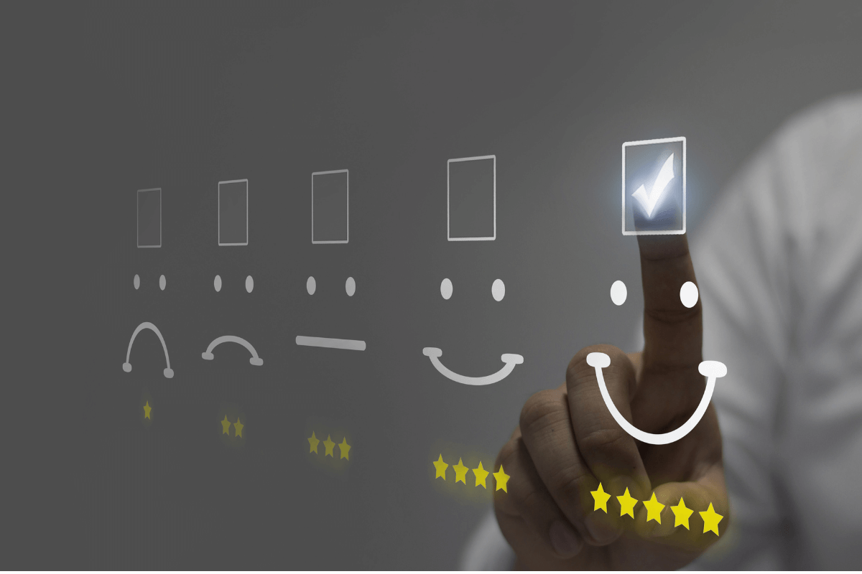
3. Enhanced Customer Experience.
Confidence Purchases.
Personalization and education.
Accessibility and Convenience.
4. Social Impact
Makes eyewear accessible to rural customers via system.
Reduces shopping stress and decision fatigue.
Builds digital literacy across age groups.

Slide 9
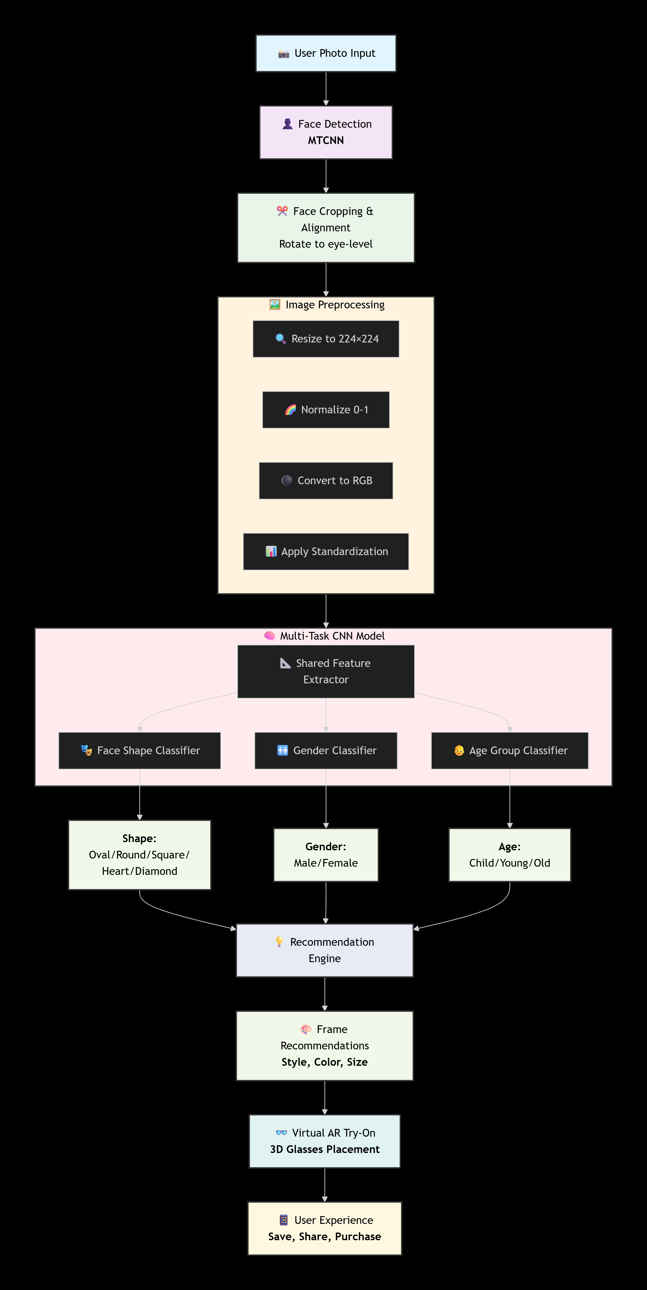
How LOOK Works:
Step-by-Step Process
Flow

Slide 10
Thank you!
Stay tuned to discover your perfect look.

